Slide 1

Heredity and Evolution
Variation
Heredity

Slide 2

What is the mechanism by which variation are created and passed from one generation to another ???

Slide 3
Lets understand variations with an illustration

Slide 4
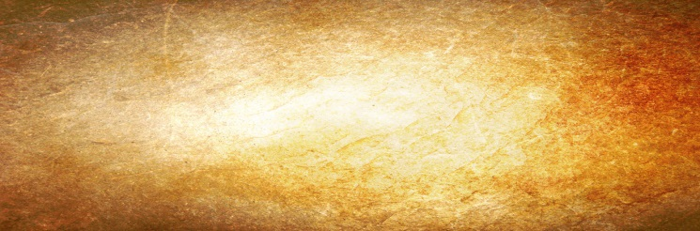
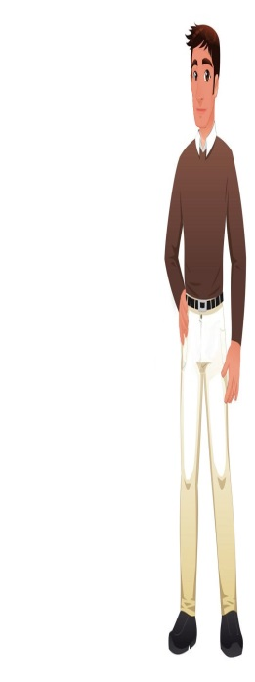
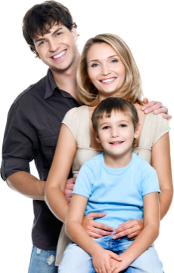
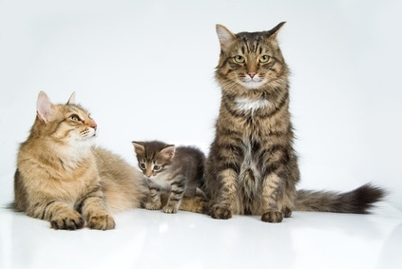
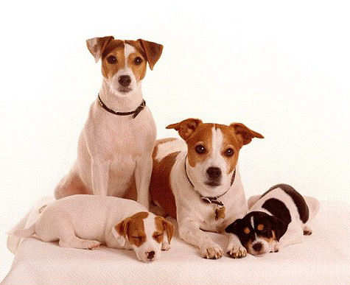
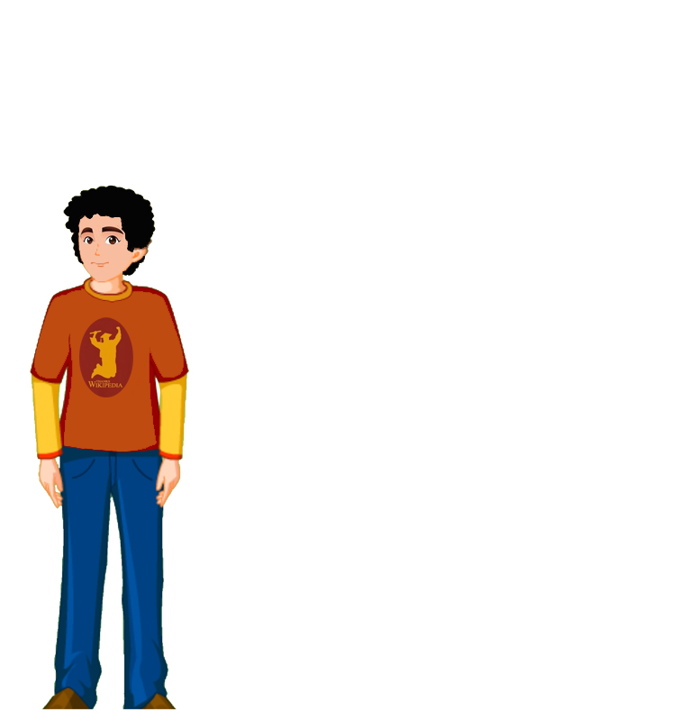
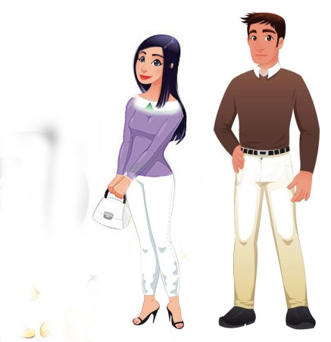
Inheritance from the previous generation provides both
a common basic body design
Variations are created and passed from one generation to another
Child gets the height from his father
and subtle changes in it, for the next generation.
Child gets the skin colour from his mother
Father
Child
Mother

Slide 5
Transfer of characters from one generation to another is called as heredity
Father
Child
Mother

Slide 6
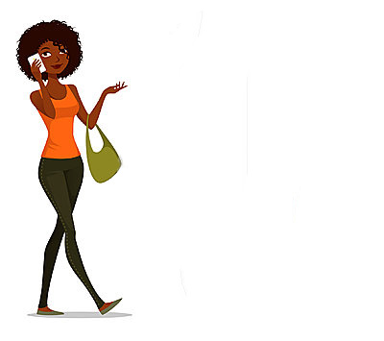
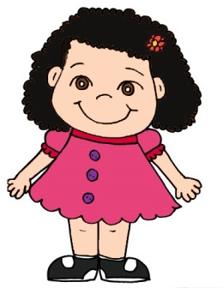
When this new generation reproduces.
The second generation will have differences
that they inherit from the first generation,
as well as newly created differences.
Father
Child
Mother

Slide 7
Thank You

